Slide 1
Using the fx-CG50 for statistics
Calculator functionality

Slide 2
How our teaching resources are designed for the classroom

Slide 3
I can use the fx-CG50 to perform calculations with data.

Slide 4
The frequency is the number of times an event occurs; or the number of individuals (people, animals etc.) with some specific property.
The (arithmetic) mean for a set of numerical data is the sum of the values divided by the number of values. It is a measure of central tendency representing the average of the values.
The median is the central (middle) piece of data when the data are in numerical order. It is a measure of central tendency representing the average of the values.

Slide 5
The mode is the most frequent value. It is a measure of central tendency representing the average of the values.
A statistical summary sums up the features of a data set. It may contain the mean, median and/or mode which measure the central tendency. It may also contain the range which measures the spread.

Slide 6

Using the fx-CG50 for statistics
Numerical summaries of data
Graphical representations of data

Slide 7
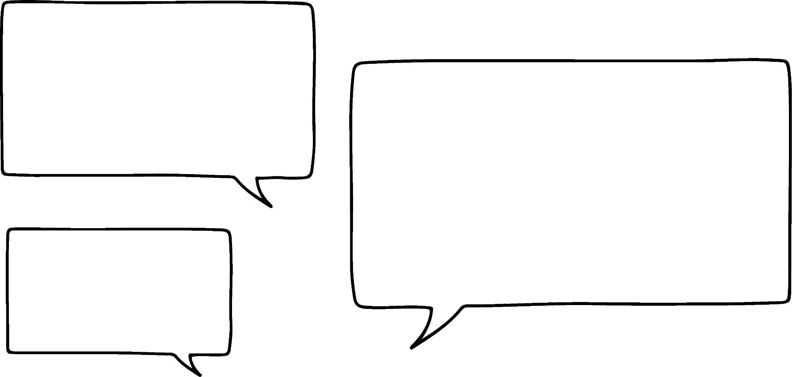


Numerical summaries of data
The (arithmetic) mean for a set of numerical data is the sum of the values divided by the number of values.
Does this mean I need to use the calculate mode to add all the numbers before dividing?
There is an easier way to calculate the mean.
Izzy
Jun

Slide 8
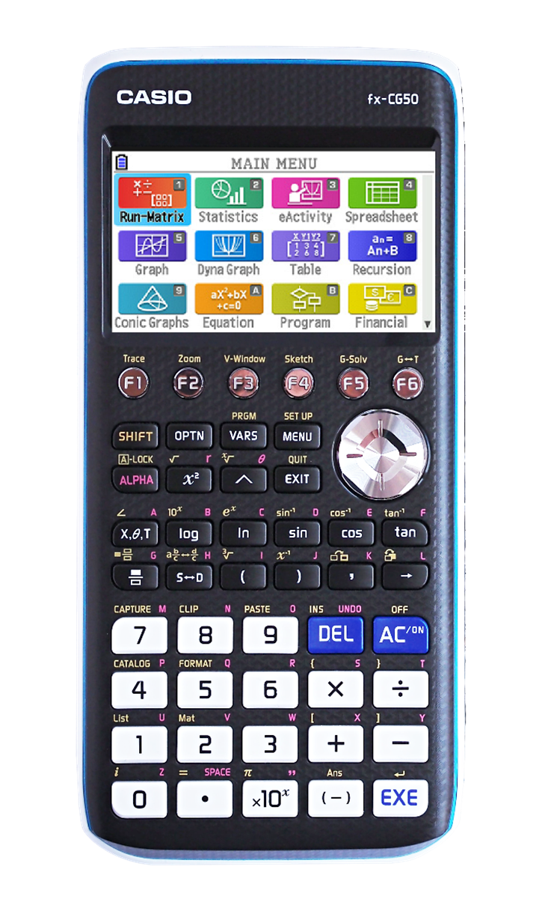
Numerical summaries of data
The fx-CG50 allows you to produce a statistical summary quickly.
From the main menu, navigate to the ‘Statistics’ option and press ‘EXE’.

Slide 9
Numerical summaries of data
Group size | Frequency
0 | 1
1 | 1
2 | 2
3 | 2
4 | 3
5 | 2
Here is a table showing the number of diners at various tables in a restaurant.
This represents 3 tables, each with 4 diners.
This represents 2 tables, each with 5 diners.

Slide 10
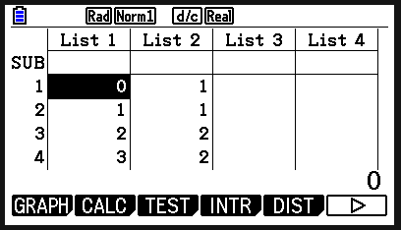
Numerical summaries of data
Group size | Frequency
0 | 1
1 | 1
2 | 2
3 | 2
4 | 3
5 | 2
Enter the data in the same order into the table on the screen.

Slide 11
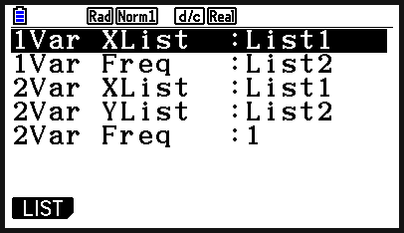
Numerical summaries of data
Group size | Frequency
0 | 1
1 | 1
2 | 2
3 | 2
4 | 3
5 | 2
Press ‘CALC’ (F2). You now need to define what each list represents. Press ‘SET’ (F6).

Slide 12
Numerical summaries of data
Group size | Frequency
0 | 1
1 | 1
2 | 2
3 | 2
4 | 3
5 | 2
1Var XList: should say List 1.
1Var Freq: should say List 2. (This is what each list represents in our table.)
You can use ‘LIST’ (F1) to change this if needed.

Slide 13
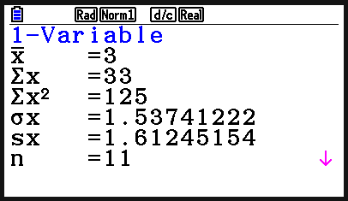
Numerical summaries of data
Group size | Frequency
0 | 1
1 | 1
2 | 2
3 | 2
4 | 3
5 | 2
Press ‘EXIT’ and then select ‘1-VAR’ (F1), to produce the statistical summary. You can scroll down to see more.
The mean is written as

Slide 14
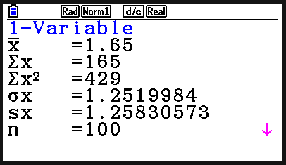
Numerical summaries of data
This frequency table shows the number of goals scored in each match by all the teams in a club over one football season.
Goals scored | Frequency
0 | 19
1 | 34
2 | 21
3 | 15
4 | 11
What was the mean number of goals scored?
1.65 goals (which rounds to 2)

Slide 15
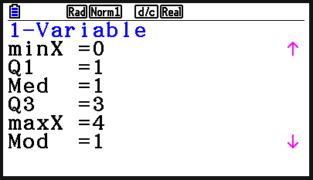
Numerical summaries of data
This frequency table shows the number of goals scored in each match by all the teams in a club over one football season.
Goals scored | Frequency
0 | 19
1 | 34
2 | 21
3 | 15
4 | 11
What was the median number of goals scored?
1 goal

Slide 16
Numerical summaries of data
The (arithmetic) mean for a set of numerical data is the sum of the values divided by the number of values.
But what if I have a grouped frequency table?
Your calculator can still find an estimate for the mean.
Izzy
Jun

Slide 17
Numerical summaries of data
57 people were surveyed and asked how much money they spent on food during their visit to Oakfield supermarket.
amount spent (in £) | frequency (f )
£0 < £ ≤ £20 | 20
£20 < £ ≤ £50 | 14
£50 < £ ≤ £100 | 10
£100 < £ ≤ £200 | 8
£200 < £ ≤ £300 | 5
To calculate an estimate for the mean, we need to use the midpoint for each class.

Slide 18
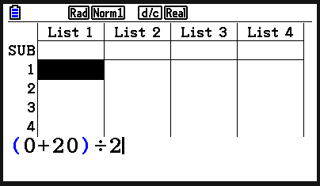
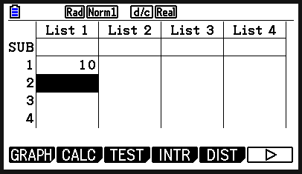
Numerical summaries of data
57 people were surveyed and asked how much money they spent on food during their visit to Oakfield supermarket.
amount spent (in £) | frequency (f )
£0 < £ ≤ £20 | 20
£20 < £ ≤ £50 | 14
£50 < £ ≤ £100 | 10
£100 < £ ≤ £200 | 8
£200 < £ ≤ £300 | 5
The calculator can do this for you:
Enter the calculation and press ‘EXE’.

Slide 19
Numerical summaries of data
57 people were surveyed and asked how much money they spent on food during their visit to Oakfield supermarket.
amount spent (in £) | frequency (f )
£0 < £ ≤ £20 | 20
£20 < £ ≤ £50 | 14
£50 < £ ≤ £100 | 10
£100 < £ ≤ £200 | 8
£200 < £ ≤ £300 | 5
The calculator can do this for you:
The midpoint is displayed in the first column.

Slide 20
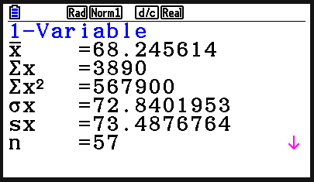
Numerical summaries of data
57 people were surveyed and asked how much money they spent on food during their visit to Oakfield supermarket.
amount spent (in £) | frequency (f )
£0 < £ ≤ £20 | 20
£20 < £ ≤ £50 | 14
£50 < £ ≤ £100 | 10
£100 < £ ≤ £200 | 8
£200 < £ ≤ £300 | 5
Calculate an estimate for the mean amount spent per visitor.
£68.25 is the estimated mean amount spent per visitor.

Slide 21
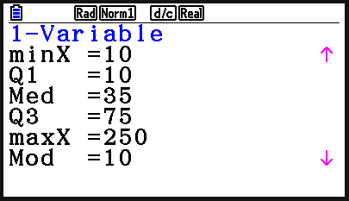
Numerical summaries of data
57 people were surveyed and asked how much money they spent on food during their visit to Oakfield supermarket.
amount spent (in £) | frequency (f )
£0 < £ ≤ £20 | 20
£20 < £ ≤ £50 | 14
£50 < £ ≤ £100 | 10
£100 < £ ≤ £200 | 8
£200 < £ ≤ £300 | 5
Calculate an estimate for the median amount spent per visitor.
£35 is the estimated median amount spent per visitor.

Slide 22
Numerical summaries of data
1) This frequency table shows the star rating received by a restaurant over its opening weekend.
Star rating | Frequency
1 | 12
2 | 18
3 | 21
4 | 38
5 | 45
a) What was the mean star rating?
b) What was the median star rating?

Slide 23
Numerical summaries of data
2) The frequency table shows the number of bedrooms in different houses within an area of a town.
Bedrooms | Frequency
1 | 20
2 | 93
3 | 54
4 | 33
a) What is the mean number of bedrooms?
b) What is the median number of bedrooms?

Slide 24
Numerical summaries of data
3) The time it takes for a sample of pupils to travel to school is collected in this grouped frequency table.
Time taken to travel to school (in minutes) | Frequency (f )
0 < t ≤ 4 | 28
4 < t ≤ 10 | 23
10 < t ≤ 16 | 70
16 < t ≤ 26 | 52
26 < t ≤ 40 | 30
40 < t ≤ 60 | 13
a) What is the estimated mean travel time (to the nearest minute)?
b) What is the estimated median travel time (to the nearest minute)?

Slide 25
Numerical summaries of data
1) This frequency table shows the star rating received by a restaurant over its opening weekend.
Star rating | Frequency
1 | 12
2 | 18
3 | 21
4 | 38
5 | 45
a) What was the mean star rating?
3.64… stars (which rounds to 4)
b) What was the median star rating?
4 stars

Slide 26
Numerical summaries of data
2) The frequency table shows the number of bedrooms in different houses within an area of a town.
Bedrooms | Frequency
1 | 20
2 | 93
3 | 54
4 | 33
a) What is the mean number of bedrooms?
2.5 bedrooms (which rounds to 3)
b) What is the median number of bedrooms?
2 bedrooms

Slide 27
Numerical summaries of data
3) The time it takes for a sample of pupils to travel to school is collected in this grouped frequency table.
Time taken to travel to school (in minutes) | Frequency (f )
0 < t ≤ 4 | 28
4 < t ≤ 10 | 23
10 < t ≤ 16 | 70
16 < t ≤ 26 | 52
26 < t ≤ 40 | 30
40 < t ≤ 60 | 13
a) What is the estimated mean travel time (to the nearest minute)?
18 minutes
b) What is the estimated median travel time (to the nearest minute)?
13 minutes

Slide 28
Using the fx-CG50 for statistics
Numerical summaries of data
Graphical representations of data

Slide 29
Graphical representations of data
The fx-CG50 can plot scatter graphs and draw a line of best fit.
Wow! That’s amazing!
It can perform calculations needed for A Level maths.
Izzy
Jun

Slide 30
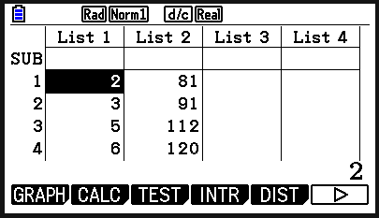
Graphical representations of data
The data below shows the age and heights for a sample of six children. What do you notice about this data?
ages (years) | height (cm)
2 | 81
3 | 91
5 | 112
6 | 120
7 | 124
11 | 138
You can plot this scatter graph on your calculator using the ‘Statistics’ mode.
Enter the data into the table.

Slide 31
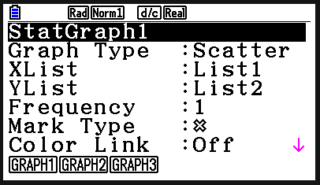
Graphical representations of data
The data below shows the age and heights for a sample of six children. What do you notice about this data?
ages (years) | height (cm)
2 | 81
3 | 91
5 | 112
6 | 120
7 | 124
11 | 138
Press ‘GRAPH’ (F1). Pressing ‘SET’ (F6) lets you determine which variable is on which axis and what the points will look like. (Mark type.)

Slide 32
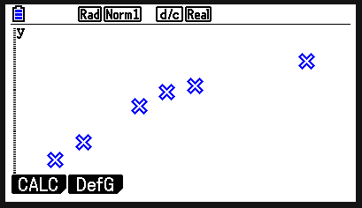
Graphical representations of data
The data below shows the age and heights for a sample of six children. What do you notice about this data?
ages (years) | height (cm)
2 | 81
3 | 91
5 | 112
6 | 120
7 | 124
11 | 138
Press ‘EXIT’ and then select ‘GRAPH1’ (F1).

Slide 33
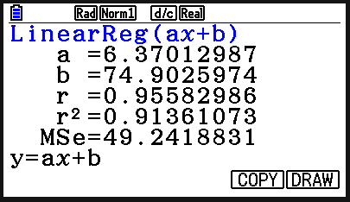
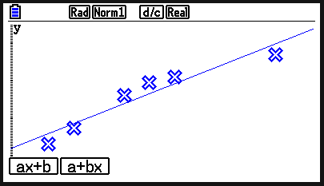
Graphical representations of data
The data below shows the age and heights for a sample of six children. What do you notice about this data?
ages (years) | height (cm)
2 | 81
3 | 91
5 | 112
6 | 120
7 | 124
11 | 138
Press ‘CALC’ (F1), then X (F2) and then ‘ax+b’ (F1).
On the next screen, press ‘DRAW’ (F6) to see the line of best fit.

Slide 34
Graphical representations of data
The data below shows the age and heights for a sample of six children. What do you notice about this data?
ages (years) | height (cm)
2 | 81
3 | 91
5 | 112
6 | 120
7 | 124
11 | 138
There appears to be a positive correlation. The older a child is, the taller they are.

Slide 35
Graphical representations of data
The data below shows the volume of water in a container over a period of time.
a) Which variable should be plotted on the x-axis?
Water (l) | 0.25 | 0.63 | 0.78 | 1.11 | 1.29 | 1.57
Time (s) | 30 | 60 | 90 | 120 | 150 | 180
The independent variable - time.

Slide 36
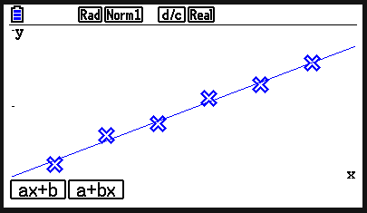
Graphical representations of data
The data below shows the volume of water in a container over a period of time.
b) Sketch the scatter graph and line of best fit. What do you notice about the data?
Water (l) | 0.25 | 0.63 | 0.78 | 1.11 | 1.29 | 1.57
Time (s) | 30 | 60 | 90 | 120 | 150 | 180
There is positive correlation. As the time increases, so does the water volume.

Slide 37
Graphical representations of data
1) The table shows weather data from Bradford, for five months in 2021.
What does this data suggest about the weather? Justify your answer.
Month | Total rainfall (mm) | Total sunshine (hours)
Feb | 100 | 66
Apr | 16 | 216
Jun | 22 | 173
Aug | 61 | 126
Oct | 93 | 86

Slide 38
Graphical representations of data
2) Jacob runs a series of long-distance races. For each race, he records his time and the elevation of the course. What does this data suggest about elevation and the time taken? Justify your answer.
elevation (m) | time (s)
51 | 1756
4 | 1644
35 | 1735
115 | 1911
96 | 1870

Slide 39
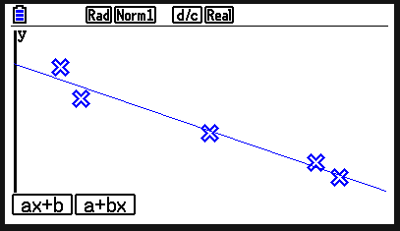
Graphical representations of data
1) The table shows weather data from Bradford, for five months in 2021.
What does this data suggest about the weather? Justify your answer.
Month | Total rainfall (mm) | Total sunshine (hours)
Feb | 100 | 66
Apr | 16 | 216
Jun | 22 | 173
Aug | 61 | 126
Oct | 93 | 86
There is negative correlation. More rain means less sunshine.

Slide 40
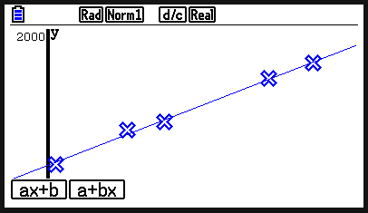
Graphical representations of data
2) Jacob runs a series of long-distance races. For each race, he records his time and the elevation of the course. What does this data suggest about elevation and the time taken? Justify your answer.
elevation (m) | time (s)
51 | 1756
4 | 1644
35 | 1735
115 | 1911
96 | 1870
There is positive correlation. The greater the elevation, the more time it takes to run the course.

Slide 41
Using the fx-CG50 for statistics
Some calculators can perform more than just basic calculations.
The fx-CG50 can produce a statistical summary of a set of data.
The summary includes the mean, median, upper and lower quartiles.
The fx-CG50 can produce graphical representations of data.

Slide 42

© Oak National Academy 2025.
Produced in partnership with Casio and Mathematics in Education and Industry.
Licensed on the Open Government Licence v3.0, except where otherwise stated. See Oak terms and conditions.

